Slide 1
Agreement Protocols
Edited Slides of Prof Pallab Dasgupta

Slide 2
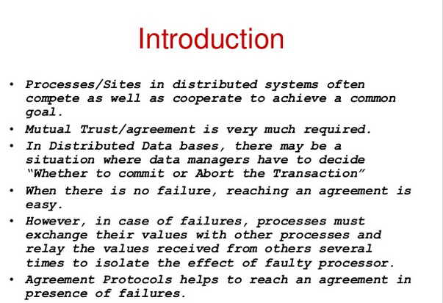

Slide 3
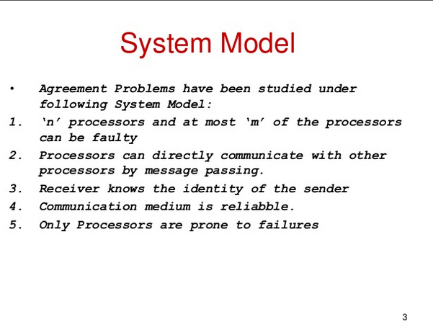

Slide 4
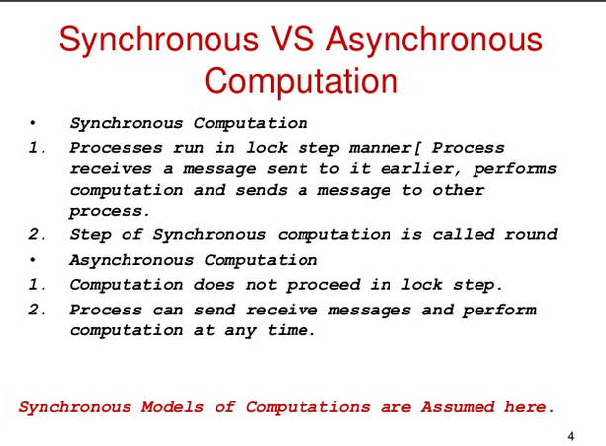

Slide 5
Applications of Consensus in Distributed Systems
Designed to achieve reliability in a network involving multiple unreliable nodes.
Required for decisions like
- Whether to commit a distributed transaction to a database
Consensus on leader (leader election)
What is the current value of the variable

Slide 6
Byzantine Agreement Problem
A designated process (source) with an initial value has to reach an agreement with the other processes about its initial value under the following conditions:
Agreement: All non faulty processes must agree on the same value
Validity: A decided value is the proposed value if the source is non faulty
Termination: Every correct process returns a value (decides)
Process is Byzantine if it deviates from some specification
-behave as crashed process
Send wrong information
-send different information to different processes

Slide 7
Byzantine Agreement
One process x broadcasts a value v
Agreement Condition: All non-faulty processes must agree on a common value.
Validity Condition: The agreed upon value by non faulty processes must be v if x is non-faulty. The agreed upon value can be any value (may not be v) if x is faulty.

Slide 8
Variants of Byzantine agreement problem
Consensus
Each process broadcasts its initial value
All non-faulty processes must agree on a common value.
If initial value of all non-faulty processes is v, then the agreed upon value must be v
Interactive Consistency
Each process k broadcasts its own value v_{k}
All non-faulty processes agree on a common vector (v₁,v₂,…,v_{n})
If the k^{th} process is non-faulty and its initial value is v_{k}, then the k^{th} value in the vector agreed upon by non-faulty processes must be v_{k}. If kth process process is faulty then the kth value agreed upon by the non faulty process can be any value
Solution to Byzantine agreement problem implies solution to other two

Slide 9
Byzantine solution for Interactive Consistency
Solving Interactive Consistency using the Byzantine Solution
Interactive Consistency: Each process k broadcasts its own value v_{k.} All non-faulty processes agree on a common vector (v₁,v₂,…,v_{n}). If the k^{th} process is non-faulty, then the k^{th} value in the vector agreed upon by non-faulty processes must be v_{k}
Run the Byzantine solution on each process. Let the value broadcast by process 1 to n be v₁,v₂,…,v_{n.}
By the Byzantine solution, for each process Pi initiating the byzantine agreement solution, every non faulty process will agree on its value vi. Thus every non faulty process has agreed on the same value for each process that has initiated. The vector (v₁,v₂,…,v_{n}) is thus known and the same for every non faulty process. Satisfies Interactive Consistency

Slide 10
Interactive Consistency for Consensus
Solving Consensus Problem using Interactive Consistency Consensus Problem: Each process broadcasts its initial value
All non-faulty processes must agree on a common value.
If initial value of all non-faulty processes is v, then the agreed upon value must be v
Run the Interactive Consistency solution. Each non faulty process lands up with a common vector. Use a function that decides which among these to pick. Majority,min, max etc function could be used.
Hence given a solution to the Byzantine Problem we have a solution to both Consensus and Interactive Consistency Problem

Slide 11
Overview of Results
Agreement impossible in asynchronous case.
Even if we only want to tolerate a single crash failure.
True both for message passing and shared read-write memory. In a synchronised system, all systems will stop at certain points, sychronise and then move forward together. We study algorithms further for a sychronised setting.

Slide 12
Consensus Algorithm for Crash Failures (synchronous system)
n processes,
upto f < n processes may fail.
Crash failure indicates that the node can crash before/between/after sending msgs but wont send wrong messages. Once it crashes it stops participating in any further activity forever.
The consensus variable x is integer value.
Each process has an initial value xi.
Upto f+1 rounds are executed
In each round process pi sends its value xi to all process if that value has not been sent before.
Process pi then takes min of all values received in the round and its own value.
Updates its own value to the min calculated
At the end of f+1 rounds all correct processes decide the same value.

Slide 13
Consensus Algorithm for Crash Failures (synchronous system)
Code for each processor:
v := my input
at each round 1 through f+1:
if I have not yet sent v then send v to all
wait to receive messages for this round
v := minimum among all received values and
current value of v
if this is round f+1 then decide on v

Slide 14
Correctness of Crash Consensus Algo
Termination: By the code, finish in round f + 1.
Validity: Holds since processors do not introduce spurious messages
if all inputs are the same, then that is the only value ever in
circulation.

Slide 15
Correctness of Crash Consensus Algo
Agreement:
Suppose in contradiction p_{j} decides on a smaller value, x, than does p_{i}.
Then x was hidden from p_{i} by a chain of faulty processors:
There are f + 1 faulty processors in this chain, a contradiction.
round
1
round
2
round
f
round
f+1
q₁
q₂
q_{f}
q_{f+1}
p_{j}
p_{i}

Slide 16
Proof of correctness
Suppose correct processes Pi and Pj do not decide on the same value where Pj decides on a smaller value. The only way that Pi did not receive the smaller value x is if
all the processes in the sequence in which pj received it were faulty and
pj himself received it only at the f+1th round due to which he could not send this to all processes.
Now, - If Pj received it before round f+1 then pi would have received it in the f+1 th round.
If Pj received it at the f+1th round that means that all the processes on the path from the original process with min value till Pj were all faulty but you can have only f faulty processes and there are f+1 rounds. So atleast one process was non faulty and would have relayed this min information to Pi as well.

Slide 17
Performance of Crash Consensus Algo
Number of processors n > f
f + 1 rounds
Each round you have n² messages (each process to n-1 processes = n(n-1))
Thus total number of messages = (f+1) n²
Algorithm works even for n-1 crashes as long as you run it for n rounds.

Slide 18
Byzantine Agreement Problems
Model :
Total of n processes, at most m of which can be faulty
Reliable communication medium
Fully connected
Receiver always knows the identity of the sender of a message
Byzantine faults: behave as crashed, send wrong msgs or different mgs
Synchronous system
In each round, a process receives messages, performs computation, and sends
messages.

Slide 19
Byzantine Agreement Problem
No solution possible if:
asynchronous system, or
n < (3m + 1) where n =#generals, m=#faulty generals. (2/3 non faulty majority needed)
Lower Bound:
Needs at least (m+1) rounds of message exchanges
“Oral” messages – messages can be forged / changed in any manner, but the receiver always knows the sender

Slide 20
Byzantine Agreement:All non-faulty processes must
agree on a common value. The agreed upon value by
non faulty processes must be v if x is non-faulty.
Byzantine solution does not exist for N=3 and f=1
S
S
0
0
1
1
0
T
U
0
1
T
U
1
Scenario-1: S has to decide 0. Since loyal generals hence T decides 0
Scenario-2: Here S and U must agree. S has to decide 1. U decides on 1
S
Scenario-3: T’s situation is same as Scenario 1 and U’s as scenario 2. T decides 0, U decides 1.
Here T and U should agree but couldnt
0
1
0
T
U
1

Slide 21
Assume that a byzantine soln does not exist for N<=3f and f faulty generals. This is shown by reducing Z(3,1) to Z( N<=3f,f) where Z (a,b) is the byzantine solution for a generals with b faculty generals among them.

Slide 22
Lamport-Shostak-Pease Algorithm
Algorithm Broadcast( N, t ) where t is the resilience
For t = 0, Broadcast( N, 0 ):
Pulse
1 The general sends ⟨value, x_{g}⟩ to all processes,
the lieutenants do not send.
Receive messages of pulse 1.
The general decides on x_{g}.
Lieutenants decide as follows:
if a message ⟨value, x⟩ was received from g in pulse-1
then decide on x
else decide on udef

Slide 23
Lamport-Shostak-Pease Algorithm contd..
For t > 0, Broadcast( N, t ):
Pulse
1 The general sends ⟨value, x_{g}⟩ to
all processes, the lieutenants
do not send.
Receive messages of pulse 1.
Lieutenant p acts as follows:
if a message ⟨value, x⟩ was
received from g in pulse-1
then x_{p} = x else x_{p} = udef ;
Announce x_{p} to the other
lieutenants by acting as
a general in
Broadcast_{p}( N – 1, t – 1 ) in
the next pulse
Pulse
t +1 Receive messages of pulse t +1.
The general decides on x_{g}.
For lieutenant p:
A decision occurs in
Broadcast_{q}( N – 1, t – 1 ) for
each lieutenant q
W_{p}[q] = decision in
Broadcast_{q}( N – 1, t – 1 )
y_{p} = majoity (W_{p})

